Slide 1
Gene Expression Profiling of Tobacco Exposure in Buccal Tissue
Alberto Catalano
Network-Based Data Analysis
16/06/2025

Slide 2
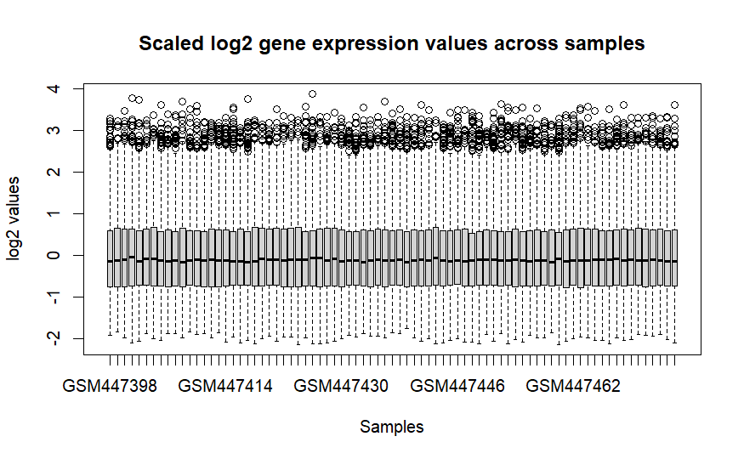
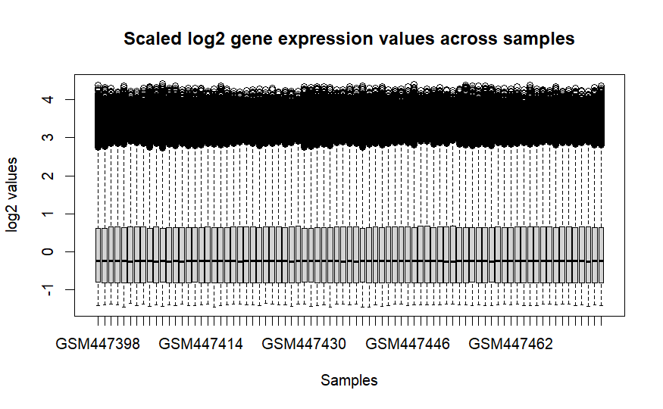



Dataset and feature selection
Dataset
GSE17913: microarray data of buccal mucosa
39 Never-smoker and 40 smoker
54675 genes
Feature selection
Variance-based filtering
T-test between the two classes (p<0.1)
803 genes
Notes:
Intro of the study
Methods first part: dataset and feature selection
The rest will only be about results, no time for methods, we explain everything

Slide 3
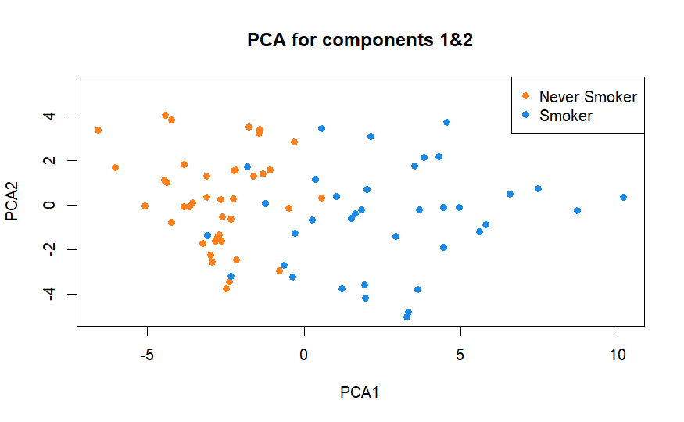
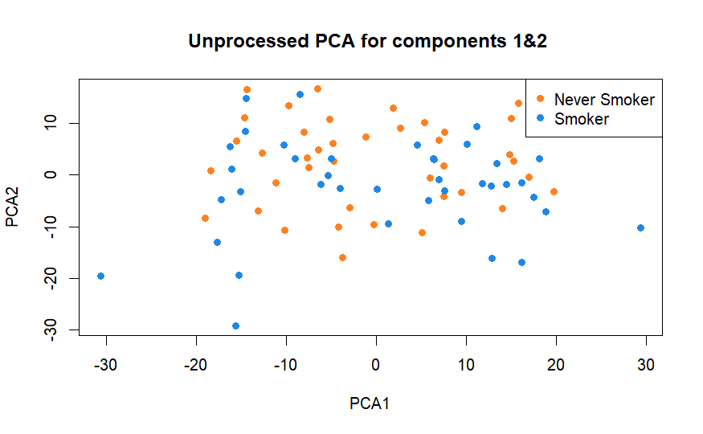
PCA Reveals Smoking-Associated Variation
PC1 & PC2 accounts for 24.1 and 9.6 % of variance
Majority of never-smoker in PC1 < 0
No observable patterns in the data
Notes:
3.1 par

Slide 4
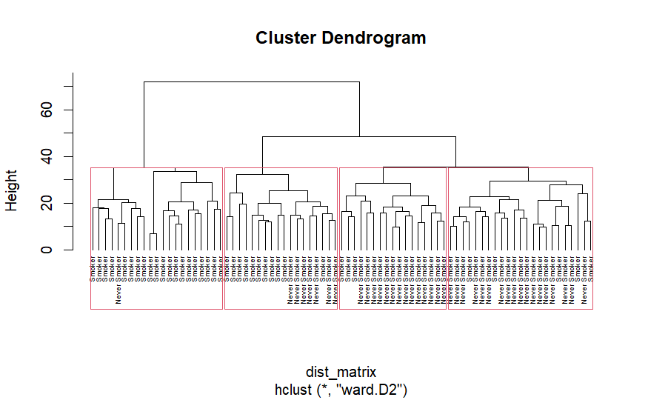
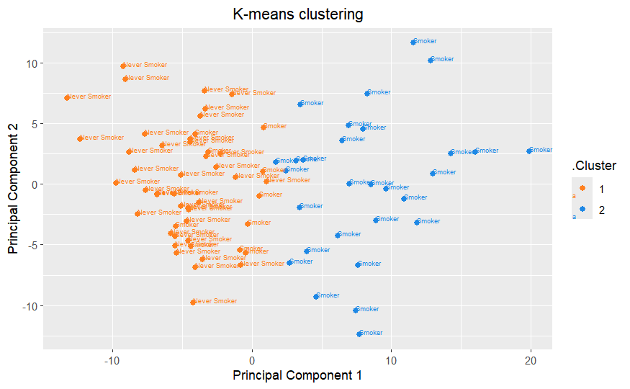
Unsupervised Clustering Validates Class Separation
Kmeans k=2
Ward distance HC k=4
Notes:
3.2

Slide 5

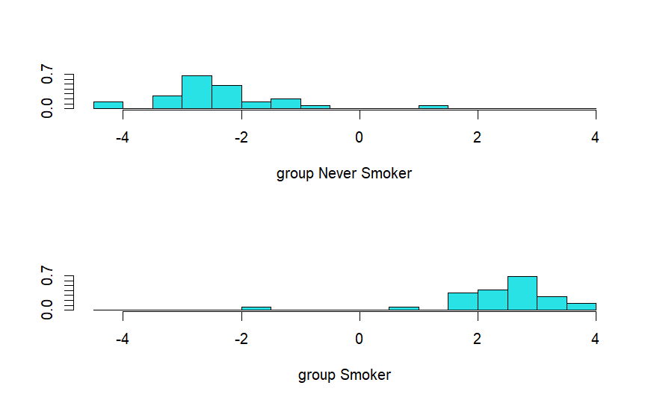
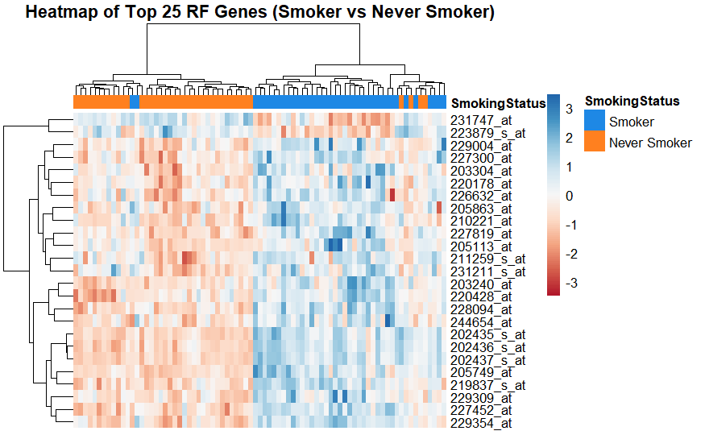
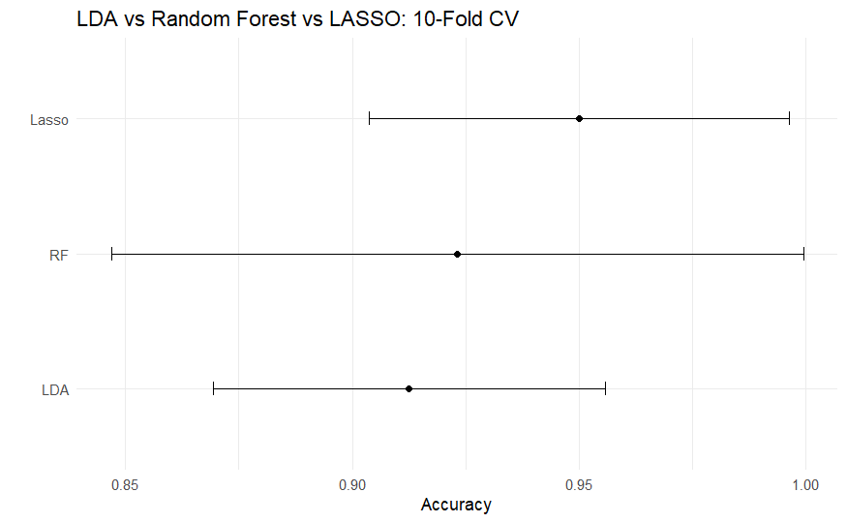
Supervised Models Achieve High Predictive Accuracy
LDA → (non overlapping separation)
RF → (up-down regulation of genes) → top 100 list
LASSO → highest accuracy → top 200 list
Notes:
3.3

Slide 6
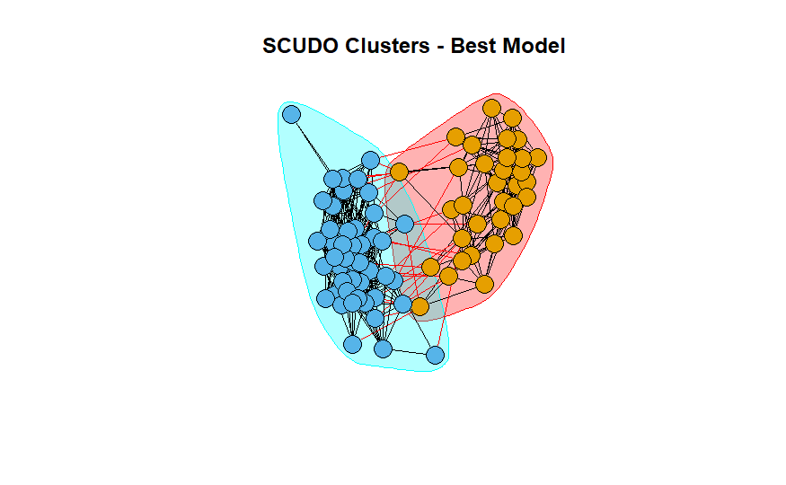
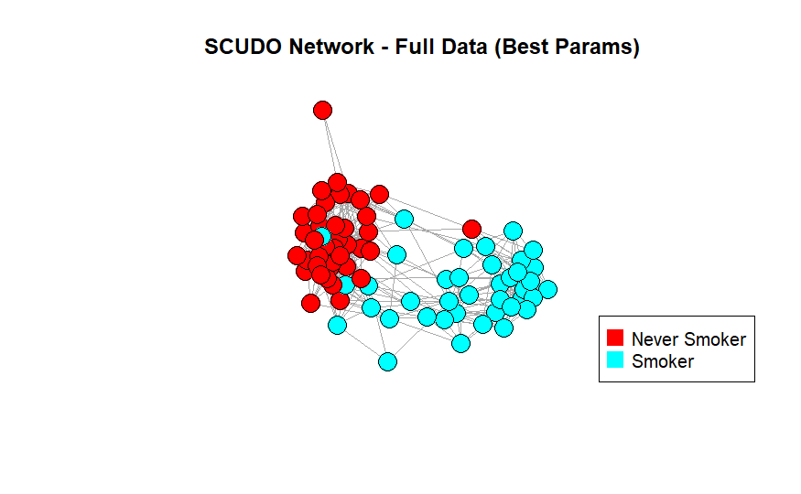
SCUDO Analysis Confirms Group Separation
SCUDO confirmed the class separation with and without prior knowledge of labels
Notes:
In the analysis I’ve also included SCUDO, that confirmed the class separation with and without prior knowledge of labels, reinforcing the validity of our results.

Slide 7
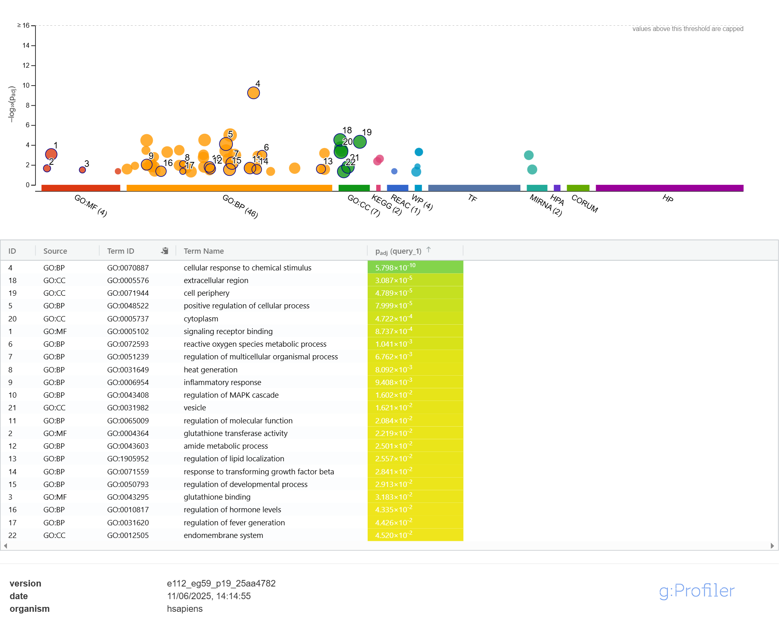
Functional Enrichment Links Gene Signatures to Smoking-Related Pathways (g:Profiler)
RF data
g:Profiler
DAVID
Main enrichments are grouped in:
Molecular Function
Biological Process
Cellular Component

Slide 8
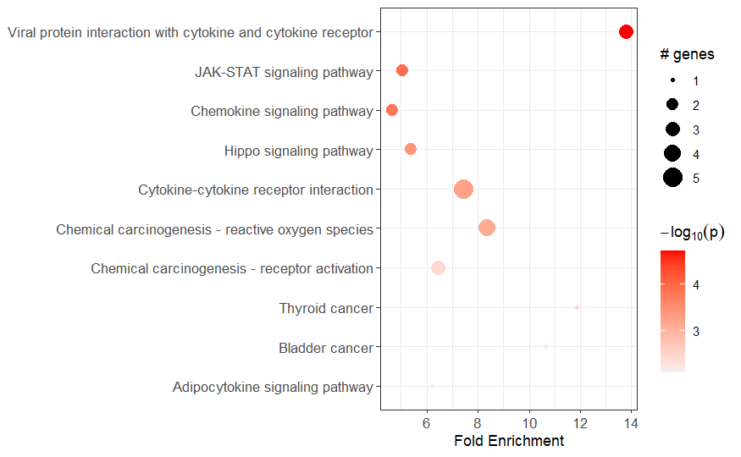
Functional Enrichment Links Gene Signatures to Smoking-Related Pathways (Pathfinder)
LASSO data
Pathfinder erichment
Identified pathways:
Chronic inflammation (Cytokines / JAK-STAT)
Carcinogenesis (chemical /thyroid / bladder)
Dysregulation of cell growth (Hippo)
Dysregulation of metabolism (Adipocytokines)

Slide 9
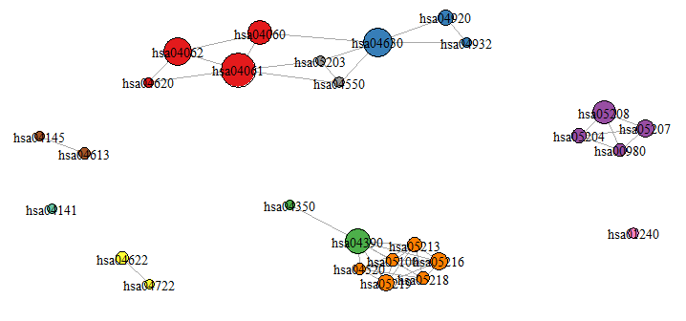
Functional Enrichment Links Gene Signatures to Smoking-Related Pathways (Pathfinder)
LASSO data
Pathfinder clusters
Clustered KEGG pathways based on gene overlap reveals several groups:
Immune and inflammatory signaling
Cancer-related pathways
Apoptosis / stress
Signal transduction
Metabolism

Slide 10
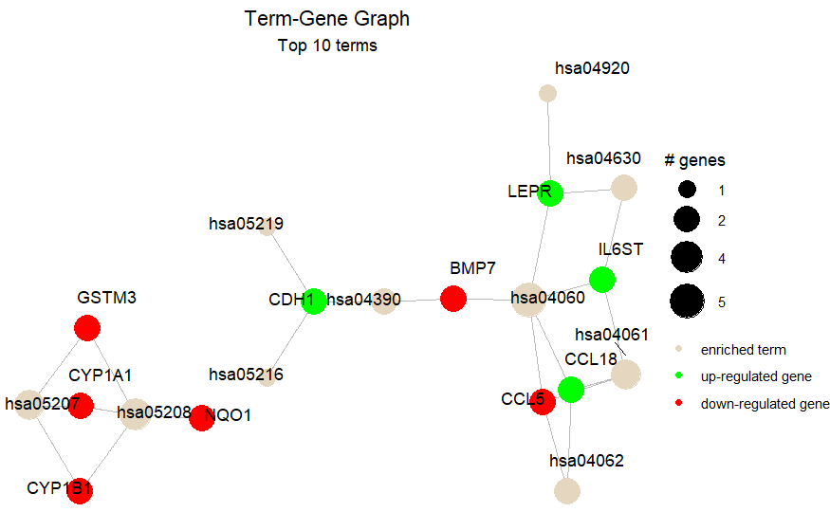

Functional Enrichment Links Gene Signatures to Smoking-Related Pathways (Pathfinder)
LASSO data
Pathfinder term-gene
Network linking predictive genes to enriched pathways reveals:
Detoxification impaired (GSTM3, CYP1A1, CYP1B1, NQO1)
Chronic inflammation (IL6ST, CCL18, LEPR)
T-cell recruitment (CCL5)
Epithelial remodelling (CDH1, BMP7)
Pro-cancerous signaling (IL6ST, CYP1B1, CPY1A1, NQO1)

Slide 11
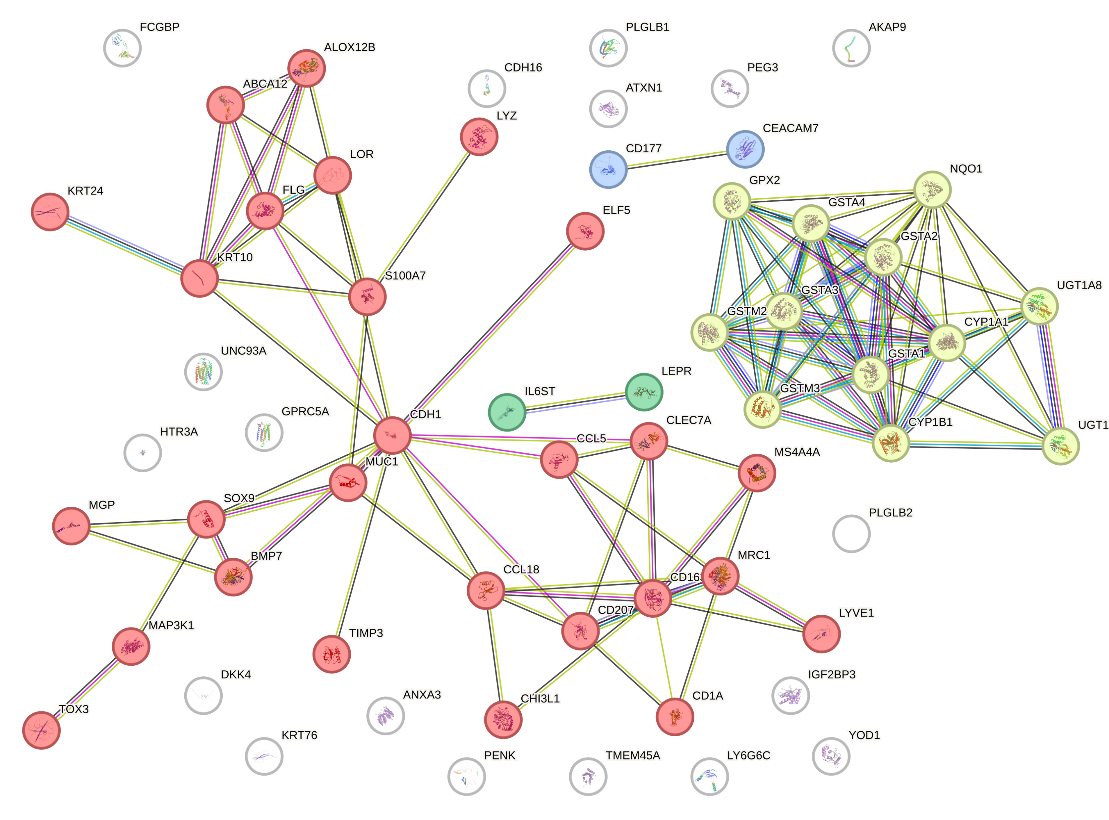

Functional Enrichment Links Gene Signatures to Smoking-Related Pathways (STRING)
LASSO data
STRING
Protein-protein (PPI) interaction network revealed 4 clusters:
Tissue damage, inflammation, remodelling (MUC1, KRT10, FLG, LOR, CCL5, CLL18, SOX9, ecc…)
Detoxification and carcinogen metabolism (GST, CYP, UGT, NQO1)
Core inflammatory signaling (IL6ST, LEPR)
Neutrophil-mediated inflammation (IL6ST, CYP1B1, CPY1A1, NQO1)

Slide 12
CONCLUSION
Dimensionality reduction techniques (PCA, k-means, hierarchical clustering) demonstrated a clear separation between smokers and never-smokers based on transcriptomic profiles.
Supervised classifiers (Random Forest, LDA, LASSO) showed high predictive accuracy, with AUC values reaching up to 0.97, confirming the robustness of gene expression signatures for classifying smoking status.
Enrichment and network-based analyses highlighted that smoking is associated with:
Reduced detoxification and deoxidation capacity
Immune suppression
Chronic inflammation
Epithelial remodelling
These alterations collectively suggest an increased cancer risk in chronic smokers due to disrupted protective and regulatory mechanisms.

Slide 13
Thank you for the attention

Slide 14
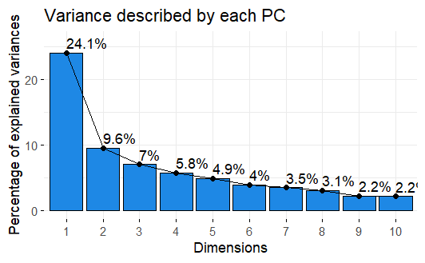

Slide 15
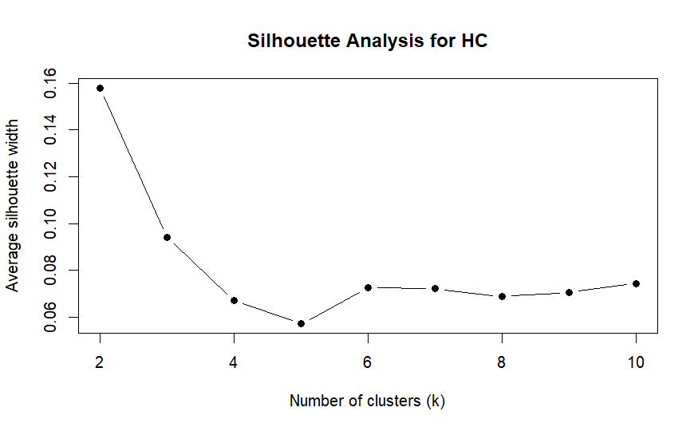

Slide 16
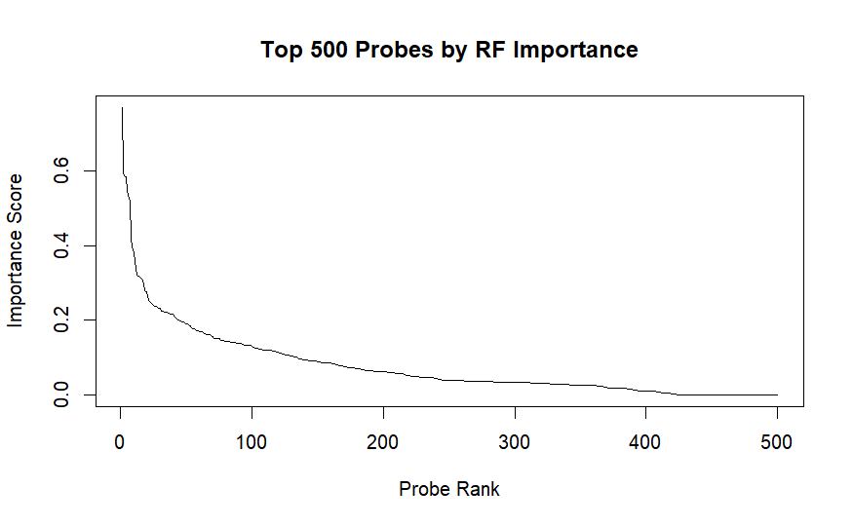

Slide 17
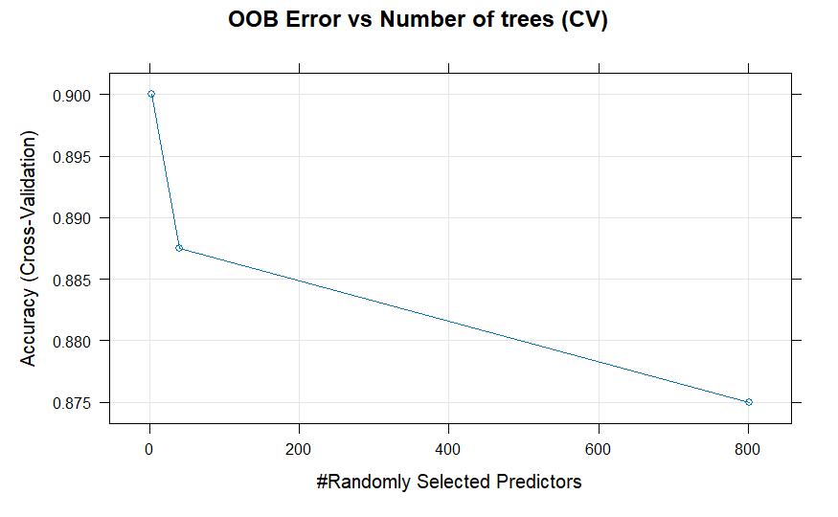

Slide 18
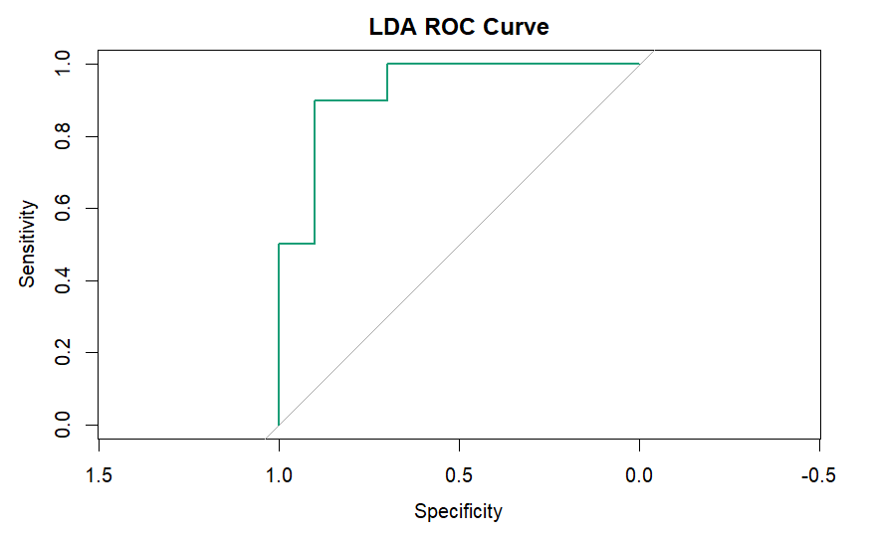

Slide 19
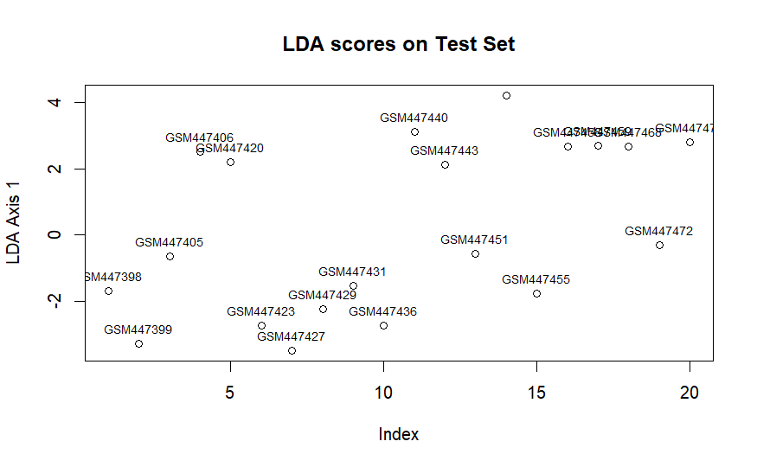

Slide 20
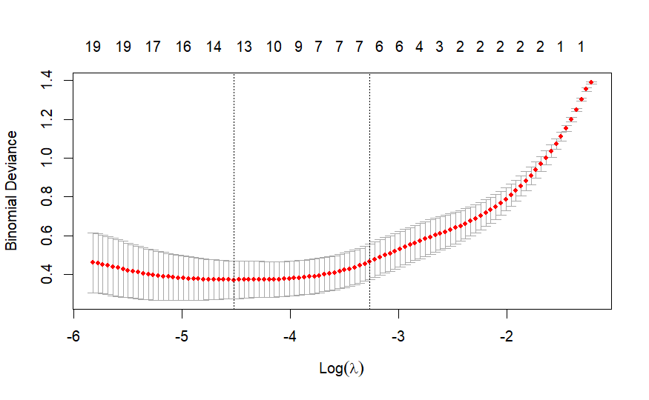

Slide 21
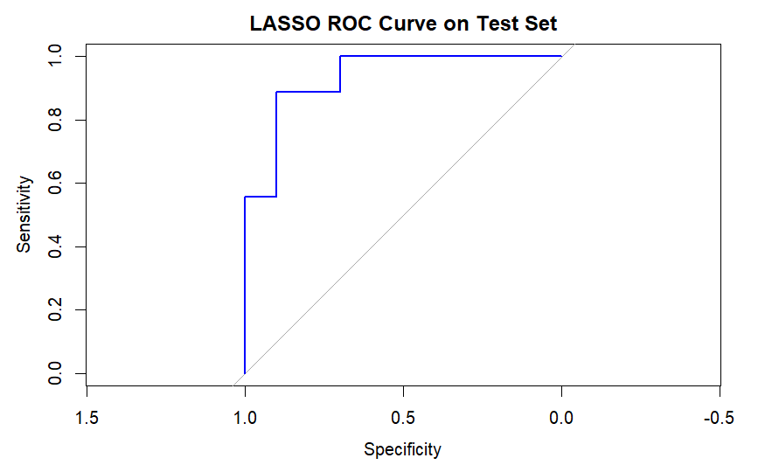

Slide 22
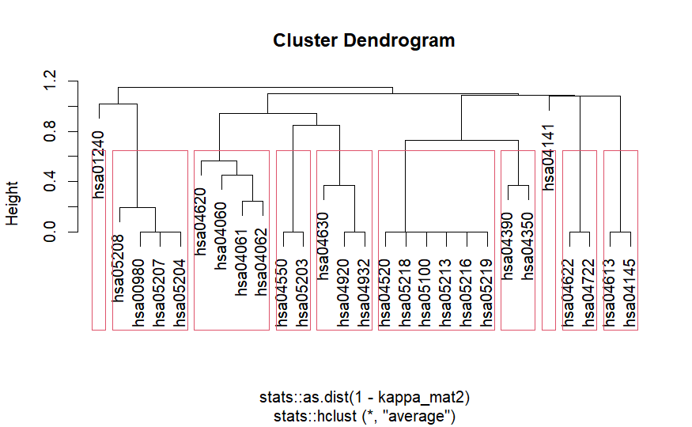

Slide 23
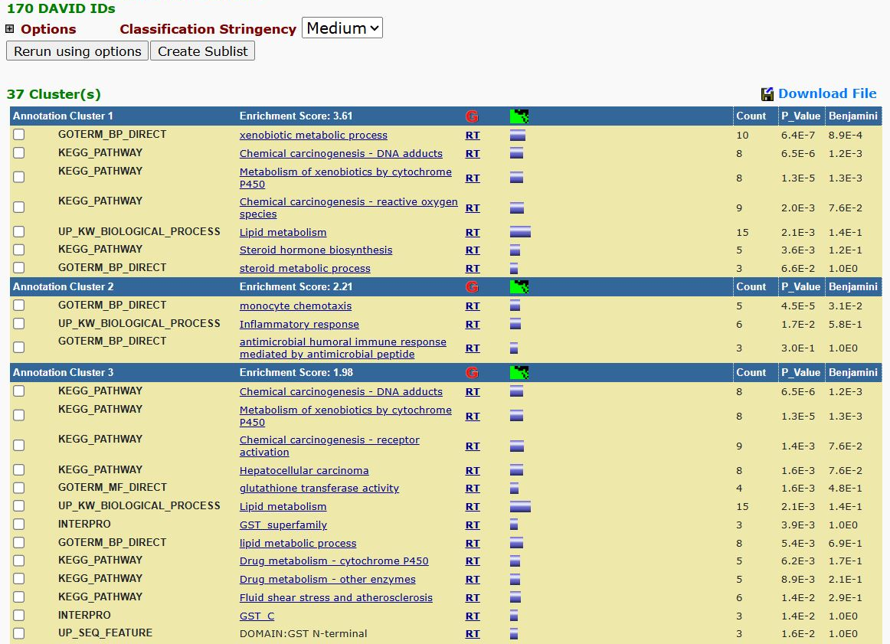

Slide 24
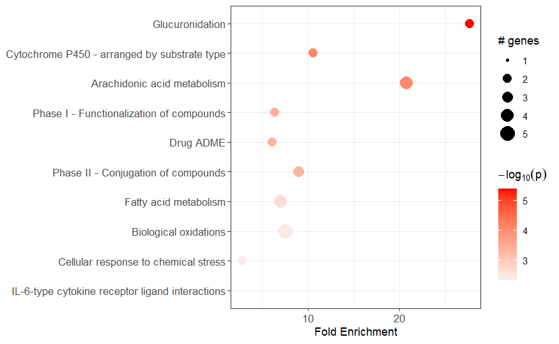

Slide 25
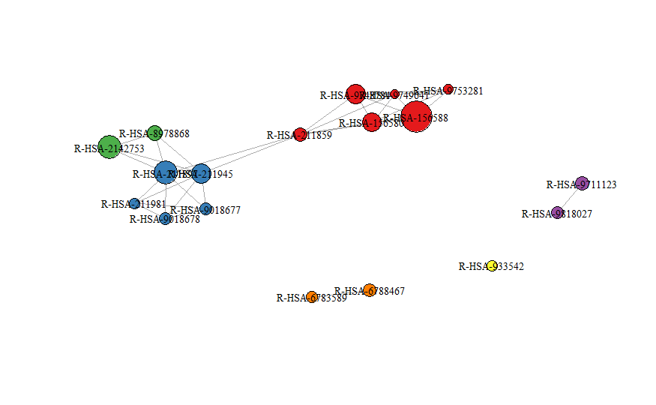

Slide 26
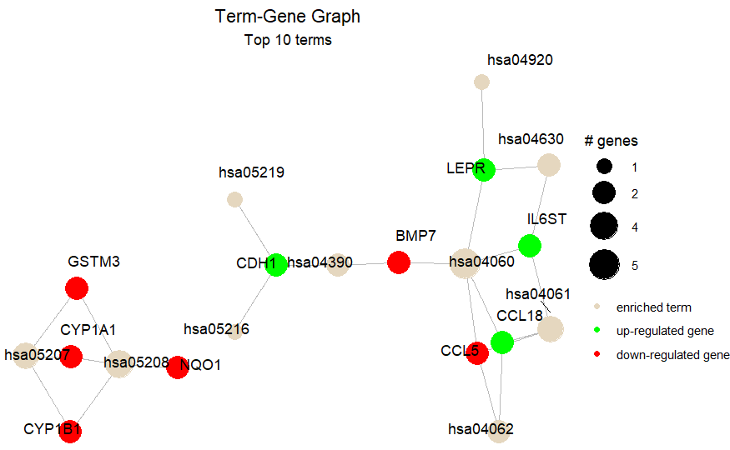

Slide 27
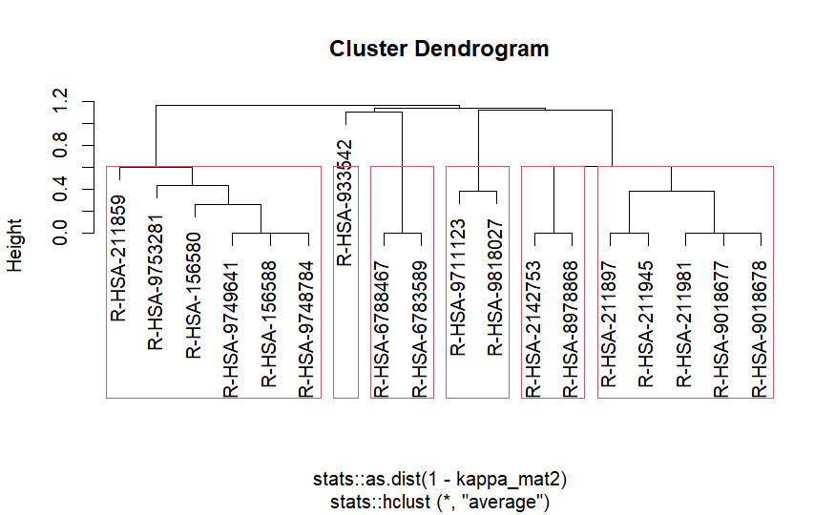

Slide 28
